Slide 1


Dataspecer · UX research proposals · 2025
IMPROVING UX OF PUBLISHED DATA SPECIFICATIONS
Progressive Disclosure
Role-Based Design
Four View Levels
Notes:
1

Slide 2



Problem Framing
The Problem
Current published specification pages behave like static technical documents
Observed Issues
Design Response
Long scrolling documentation
Browser View
Makes orientation difficult and overwhelming
To orient users and show connected specifications
Static SVG overview
Documentation View
Cannot be filtered or explored interactively
To support guided reading with filtering, grouping and sorting
Hidden connections
Graph view
Relationships between specs are hard to browse
To explore relationships and profile hierarchy visually and explore interactively
Missing implementation view
Structured developer view
Technical users lack direct code-oriented perspective
To support implementation-oriented understanding
Notes:
2

Slide 3






User Types
Three User Types
Different users need different entry points and detail levels
Beginner
Domain Expert
Technical User
Learner
Analyst
Implementer
Needs orientation, main concepts, and a clear starting point
Needs relationships, local vs inherited info, and business meaning
Needs fields, requirement levels, structure, and export views
Start in browser view
Graph + documentation
Structured developer view
Important classes first
Lineage visible
Cardinalities visible
Hide low-level details
Filter by reuse
Structured output
Notes:
3

Slide 4

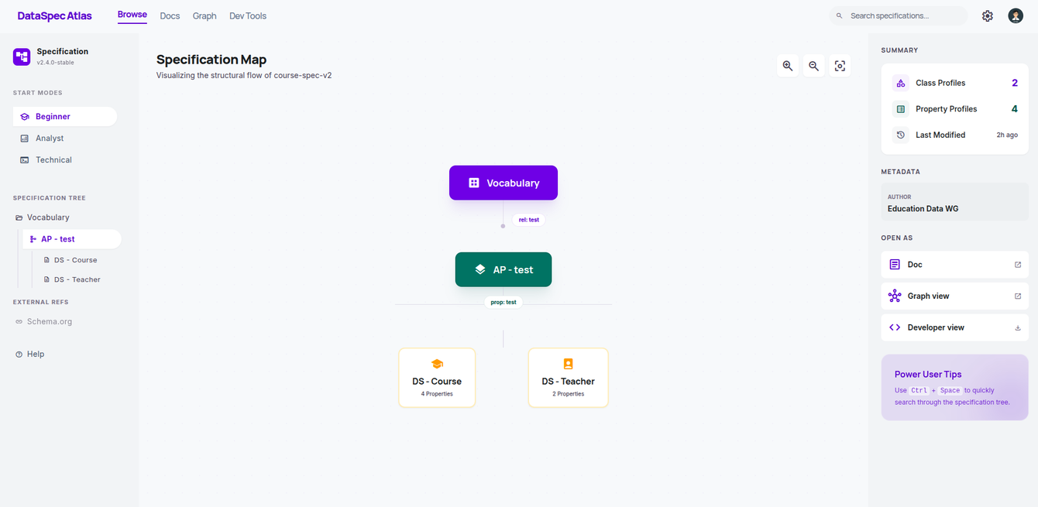
Default Entry Point
Specification Browser View
The landing page that addresses the initial orientation problem
Problem
Solution
Benefit
Users don't know where to start and cannot easily see how specifications connect
Tree on left, relationship map in center, summary/action panel on right
All user types get orientation before entering detailed views
Scalability benefit: Large ecosystems become manageable — users start from a map and drill into selected branches
Notes:
4

Slide 5
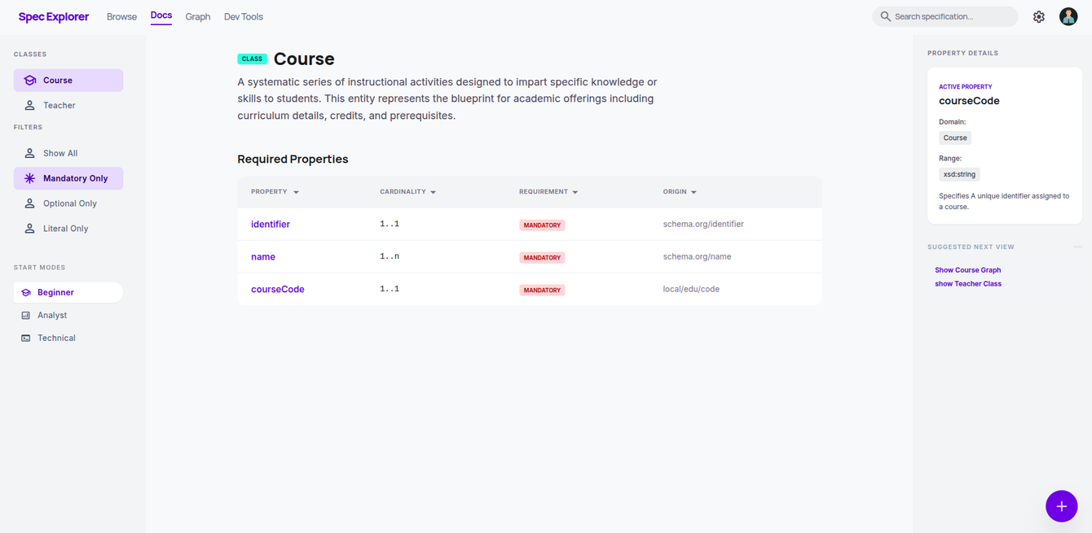
Guided Reading
Structured Documentation View
Familiar documentation made usable with navigation and filters
Problem
Solution
Benefit
Long documentation pages are hard to scan, compare, and filter
Sidebar navigation, grouped properties, requirement filters, sort, suggestions
Focus on one class at a time instead of reading the whole page linearly
Large-spec strategy: Show key classes first, keep the rest discoverable through search and filters, expand detail on demand
Notes:
6

Slide 6






Features
Features
Class-based navigation with contextual detail panels
Class Navigation
Property Rows
Suggested Start
Required Properties
Highlight entry classes, classes used in structures, and classes with mandatory properties
course_code
1..1
mandatory
local
course_name
1..1
mandatory
local
Course
Key Class
Sort By: Property Name, Cardinality etc...
Property Details
Filter
taughtBy
Domain: Course
Important First
Mandatory Only
Optional Only
Literal Only
Show All
Range: Teacher
Cardinality: 0..*
Origin: reused property profile
Customization
Beginner mode hides details; analyst mode shows lineage; technical mode shows cardinalities
Notes:
7

Slide 7
Scalability
Handling Larger Specifications
Start simple, reveal detail progressively
Strategies
How to Identify Important Classes
1
Identify Important Classes First
Root or Entry Classes
Highlight entry points and key structures before showing everything
Classes that serve as starting points in the structure
2
Progressive Disclosure
Highly Connected Classes
Show overview first, expand details only when explicitly requested
Classes with many properties or relationships
3
Smart Filters
Classes with Mandatory Properties
Class-only, requirement-only, and neighborhood-based filtering
Required fields indicate structural importance
4
Collapse Low-Priority Details
Central to Profile Relationships
Keep secondary information hidden until users choose to expand
Classes central to reuse and inheritance chains
This directly answers: What happens when the specification contains many classes and properties?
Notes:
11

Slide 8
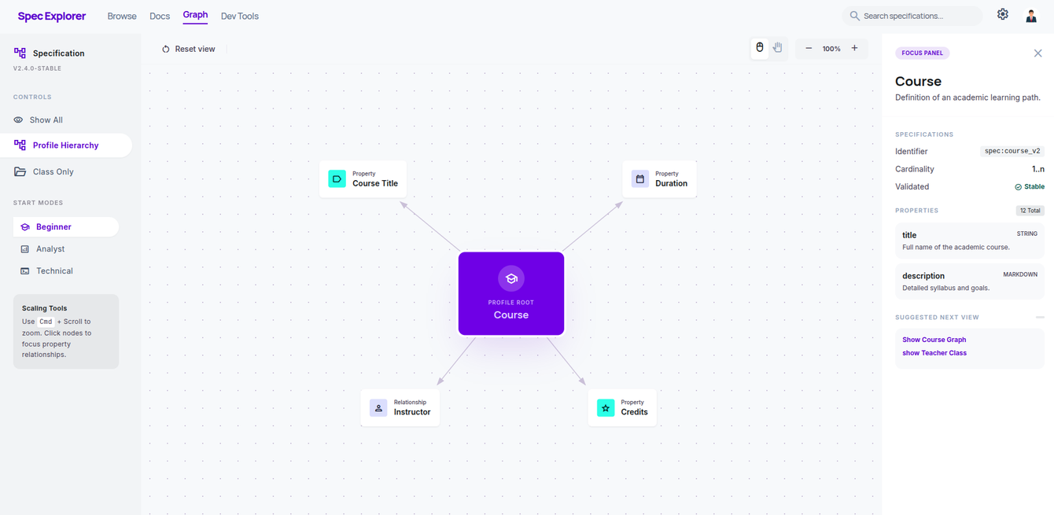
Visual Exploration
Interactive Graph View
Live graph replacing static SVG with filtering and focus
Problem
Solution
Benefit
Static SVG cannot support filtering, focus, or inspection of relationships
Interactive graph with class-only mode, profile hierarchy, requirement filters, reset view
Users can understand structure and lineage visually instead of inferring them from text
Large-spec strategy: Use focus neighborhoods, class-only mode, and profile-hierarchy mode to avoid showing the whole graph at once
Notes:
8

Slide 9









Features
Features
Mode presets and scaling tools for different analysis needs
Mode Presets
Suggested Next View
Analyst Mode
Full graph with all relationships and lineage visible
Graph Suggestion
Suggest to view Graph with profile hierarchy Next
Beginner Mode
Simplified view with key classes only
Class Suggestion
Suggest to view Another important Class Next
Technical Mode
Focus on implementation-relevant connections
Controls
Graph Elements
Reset View
Show All
Class Profile
Property Profile
Class
property
Literal
Classes Only
Profile Hierarchy
Show Mandatory
Show Optional
Notes:
7

Slide 10

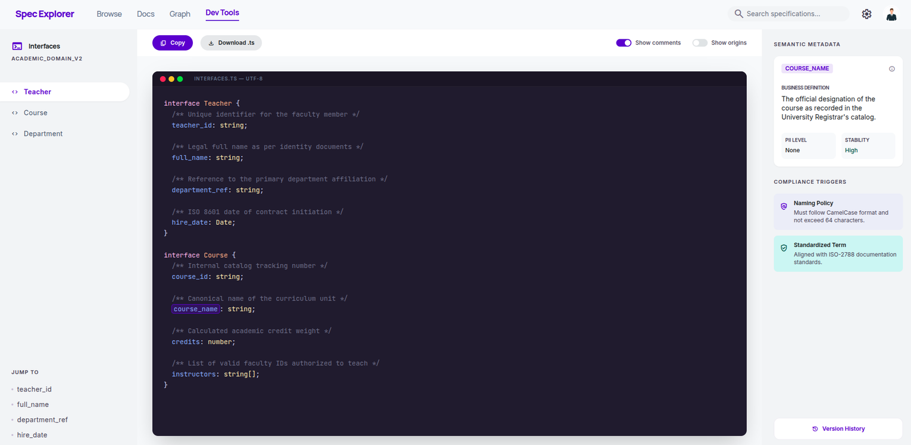
Technical Consumption
Structured Developer View
Code-like representation for implementers
Problem
Solution
Benefit
Technical users need quick implementation summary of fields, requirements, and nesting
Structured code-like view with requirement metadata and links to profile origins
Implementers understand specification without reading whole semantic document first
Notes:
10

Slide 11
THANK YOU
Notes:
10

